Slide 1
Two-screen app example

Slide 2
Objective
Create an app that has two activities (two screens)
A navigation widget (button) allows us to load the 2nd screen
While on the 2nd screen, a button allows us to close that screen and be returned to the 1st screen
We introduce the intent for the first time.

Slide 3
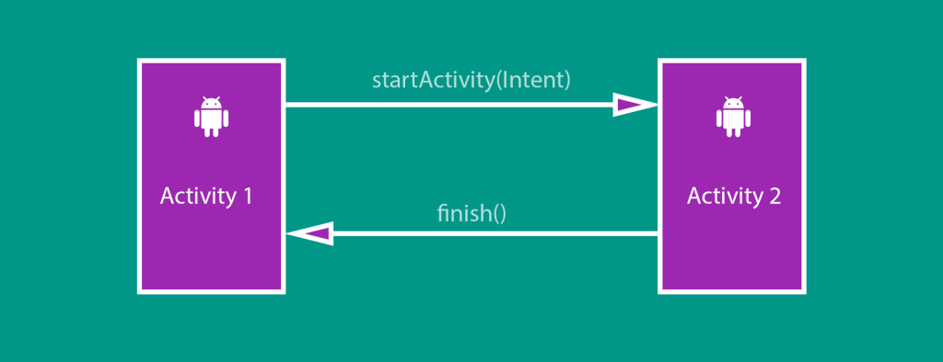
Basic design view

Slide 4
Process
Create a new project with an empty activity
Layout file for Activity 1 (MainActivity.java) is called activity_main.xml
Create the UI for Activity 1
Create Activity 2 (ProfileActivity.java) and its UI (via XML called activity_profile.xml
Complete the Java code in the two activities
Test the app via emulator or ADB (Android Debug Bridge)

Slide 5
activity_main.xml

Slide 6
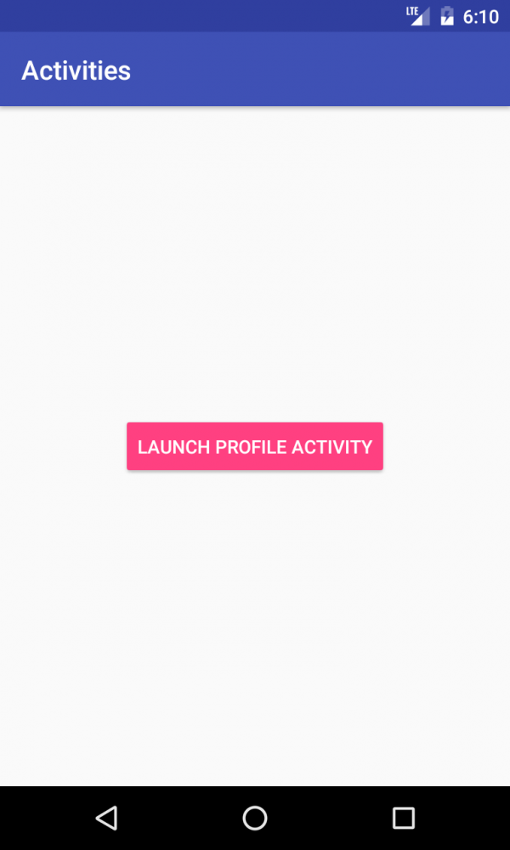
activity_main.xml design view

Slide 7
activity_profile.xml

Slide 8
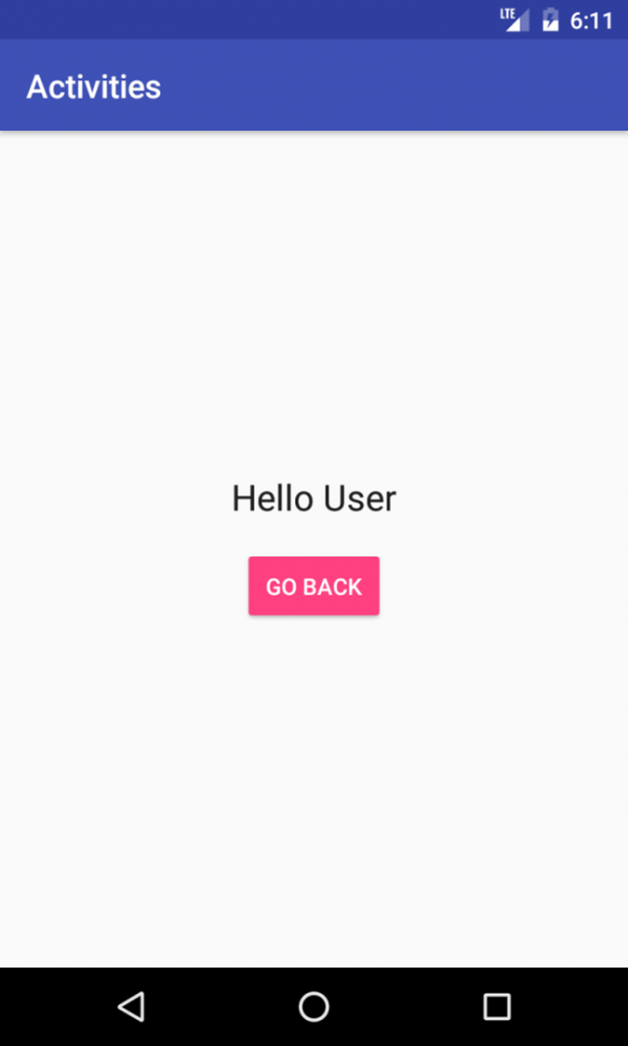
activity_profile.xml design view

Slide 9
MainActivity.java
Notes:
A listener is created for the button mBtLaunchActivity
The handler calls a method called “launchActivity()” that opens the second screen via an intent

Slide 10
ProfileActivity.java
Notes:
In this activity, we attach an OnClickListener to the Go Back button. Call the finish() method. The finish() is an Activity method which destroys the Profile Activity and sends us back to Main Activity.

Slide 11
Manifest
Every application must have an AndroidManifest.xml file
The manifest file contains essential information about your app
This information is needed by Android before it can run the app
See slide 12 for example AndroidManifest.xml file

Slide 12
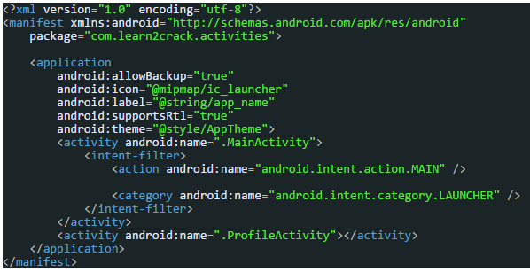
AndroidManifest.xml
Icon name
App name
Main activity name
Intent filter
Other activity name

Slide 13


Slide 14
Intents
See: http://www.vogella.com/tutorials/androidintent/article.html
An intent is an Android messages which allows an application component such as an Activity to call or request a service from other Android components.
Intents allow you to interact with components from the same application as well as with components from other applications.
As an example, your activity can use an intent to start an external activity for taking a picture.

Slide 15
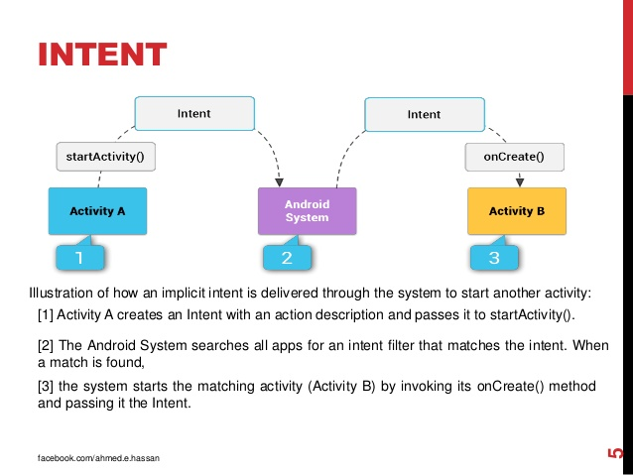
How an intent works
See: http://stackoverflow.com/questions/33099748/android-how-intent-filter-works
MAIN and LAUNCHER intent filter can only occur once in the manifest.
They indicate which activity has the main menu and the activity to be opened when the app is tapped.

Slide 16
Mini exercise 1
Create a simple app with four screens.
The main screen has three buttons each which opens one of the other three screens
Each of the other screens displays an interesting picture and has a button that, when tapped closes the screen and sends the user back to the main screen.
Upload to Bitbucket and share the app.
Do not copy code from someone else
The quiz next week will be based on this exercise

Slide 17

The end

